Slide 1



MoA Prediction - 2nd Place Solution [with 1D-CNN]
Baosen Guo
Notes:
Recommending picking out he most interesting and important parts from your documentation.

Slide 2
Agenda
Background
Local CV & Loss Function
Pre-processing
Feature Engineering
Modelling

Slide 3
Background

Slide 4
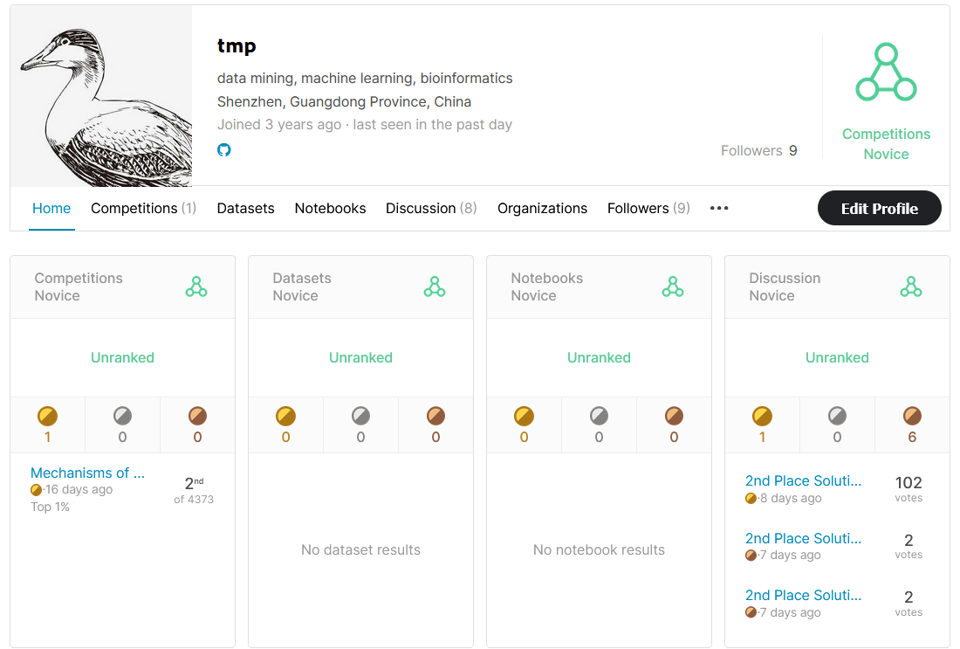
Background
Name:
Baosen Guo
(team name: tmp)
Professional background:
Data mining
Machine learning
Bioinformatics
Data mining engineer in China
Interested in genomics & biomedical data mining and deep learning.

Slide 5
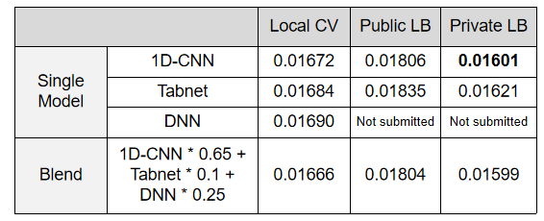
Summary
This approach consists of 3 single modes:
1D-CNN
TabNet
DNN
The final submission is generated by weighted average.
The table below lists the performance of the single modes and the final blending in this scheme.
The most important part: 1D-CNN

Slide 6
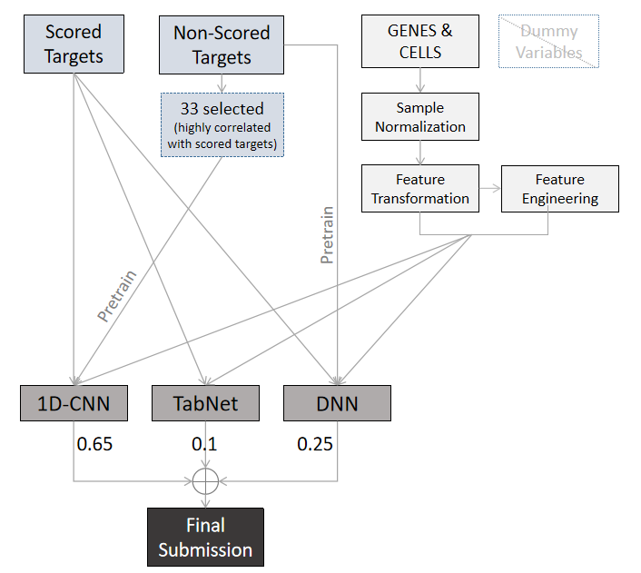
Summary
The flow chart below outlines the technical details , I will introduce it in the following sections.

Slide 7
Local CV &
Loss Function

Slide 8
Local CV & Loss Function
CV Strategy
One of the most important objectives of this challenge is to test the performance of the model for drugs that have never appeared in the public dataset.
In this competation, the "leave drug out" strategy seems to reduce the risk of over fitting in a specific group of drugs ( public lb 4th; private lb 2nd ).
Generally in genomics and biomedical data, sample type, instrument error, reagent quality and other systematic deviation sometimes affect the distribution significantly. This is inevitable in the real world, so proper assessment is very important.
Here's an example: when batch effect exists, "leave batch out" can reflect the generalization ability of the model more objectively than random kfold-split.

Slide 9
Local CV & Loss Function
Loss Function
Purpose: To deal with imbalance on targets
Solution: BCEloss with label smooth + pos_weight
label smoothing performed well by reducing the overconfident probability .
Targets weight is slightly adjusted by the reciprocal of class frequency.
Weight for each target i :
W_{i} = log ( F_{min} + 100 ) / log ( F_{i} + 100 )
Fi is the number of positive samples in target i,
Fmin donates the min positive count of all target.
The constant term 100 is added to prevent the target with low frequency (e.g., with 1 positive sample) from affecting model extremely,
Log conversion is to make it smooth.

Slide 10
Pre-processing

Slide 11
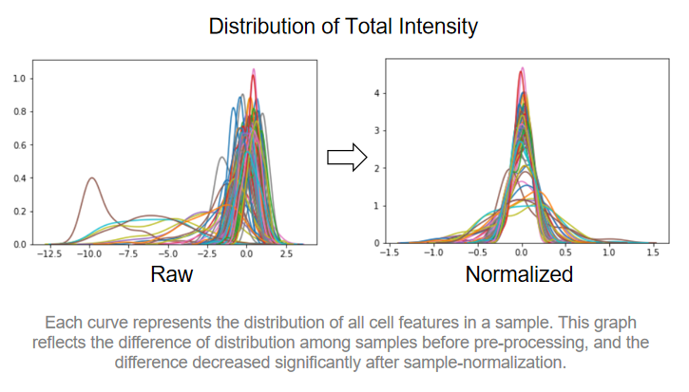
Pre-processing
Sample Normalization
[ There are some assumptions (may be wrong) ] :
The raw biological data are often not comparable due to the inevitable existence of systematic errors
Even with totally different treatments, the number of significantly different features won`t be too large.
It can be simply assume that the distributions of most samples are similar.
[ Based on these assumptions ]
the gene data in each sample is subtracted from the mean value of 25% and 75% quantiles .
the cell data is subtracted from the mean of 25% and 72% quantiles, and then divided by the 4 + 75% quantiles of the new distribution.
Feature Transformation
After sample normalization, quantile transformation is applied
on numerical features.

Slide 12
Features
Engineering

Slide 13
Features Engineering
There is nothing special in feature engineering.
Different feature processing are only used to increase the diversity.
PCA feature are used for all models with different n_components (50 genes + 15 cells for 1D-CNN, 600 genes + 50 cells for TabNet and DNN).
Statistical features (such as sum, mean) and combination features are used in Tabnet,
Variance fillter is used in Tabnet and DNN.
Dummy variable (cp_time, cp_dose) are removed in all models.

Slide 14
Modelling

Slide 15
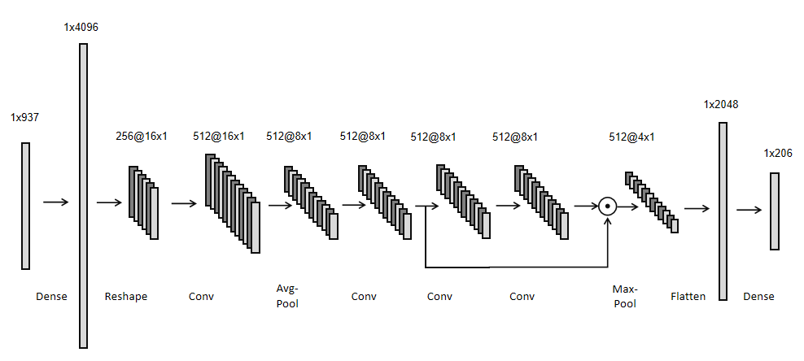
Modelling
1D-CNN - the most important part in this solution
[ Ideas ]
CNN structure is rarely used in tabular data because the correct features ordering is unknown.
A simple idea is to reshape the data directly into a multi-channel image format, and the correct sorting can be learned by using FC layer through back propagation.
[ Model Architecture ]
Feature dimension is increased through a FC layer firstly.
Next, data is directly reshaped into image format ( size 16*1, chanel 256 ).
Like the basic CNN model, features are extracted in the next several 1D-Conv layers with a shortcut-like connection.
Finally, the extracted features are used to predict targets through a FC layer after flatten.
Kaggle Winner Presentation Template

Slide 16
Modelling
1D-CNN - the most important part in this solution
[ Pre-training ]
Additionally, non-scored-targets are used alone for pre-training. In this step, only 33 non-scored-targets that are most correlated to the scored-target are trained for only 1 epoch.
The purpose of this is only to make the model better initialised. Irrelevant targets and more training steps may lead to unexpected consequences.
Kaggle Winner Presentation Template

Slide 17
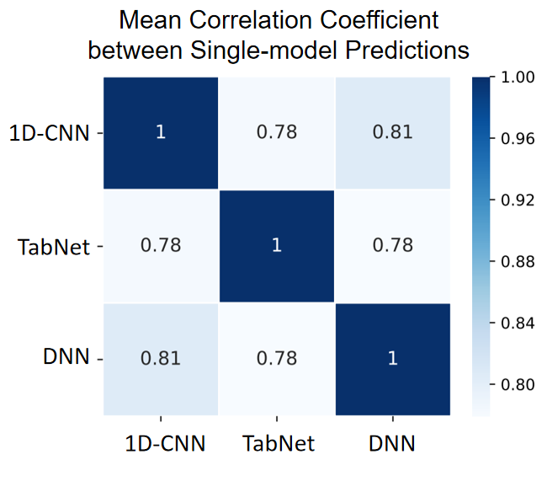
Modelling
Blending
TabNet and DNN are both similar to the public kernels.
3 single models are blended as the final submission. Compared with 1D-CNN, the final blending only improves by 0.00002, perhaps due to the lack of diversity or the insufficient number of single modes.
Kaggle Winner Presentation Template

Slide 18
Question and Answer

